Slide 1
Chapter 10. matching models
Financial Econometrics
Department of financial engineering
Zhongnan university of economics and law
Xu Yonghao

Slide 2
oUTLINE
Introduction
Propensity Score Matching
Synthetic Control

Slide 3
1 Introduction
Question：construction of infrastructure, 高铁，南水北调，电力系统（DID?）
The selection of control group and treatment group are not random.
Therefore, it does not satisfy the requirement of DID.
Case：自愿报名参加大创；参与大创对保研成功率提升的作用
PSM
Synthetic Control

Slide 4
1 Introduction
PSM（倾向性匹配得分）
In the statistical analysis of observational data, propensity score matching (PSM) is a statistical matching technique that attempts to estimate the effect of a treatment, policy, or other intervention by accounting for the covariates that predict receiving the treatment. PSM attempts to reduce the bias due to confounding variables that could be found in an estimate of the treatment effect obtained from simply comparing outcomes among units that received the treatment versus those that did not. Paul R. Rosenbaum and Donald Rubin introduced the technique in 1983

Slide 5
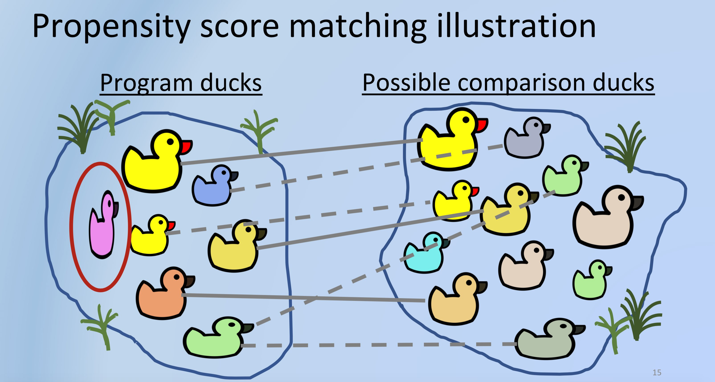
1 Introduction
source:https://twitter.com/hv_harc/status/1222992807708831745?lang=zh-Hant

Slide 6
1 Introduction
Synthetic control method（合成控制法）
The synthetic control method is a statistical method used to evaluate the effect of an intervention in comparative case studies. It involves the construction of a weighted combination of groups used as controls, to which the treatment group is compared. This comparison is used to estimate what would have happened to the treatment group if it had not received the treatment. Unlike difference in differences approaches, this method can account for the effects of confounders changing over time, by weighting the control group to better match the treatment group before the intervention. Another advantage of the synthetic control method is that it allows researchers to systematically select comparison groups

Slide 7
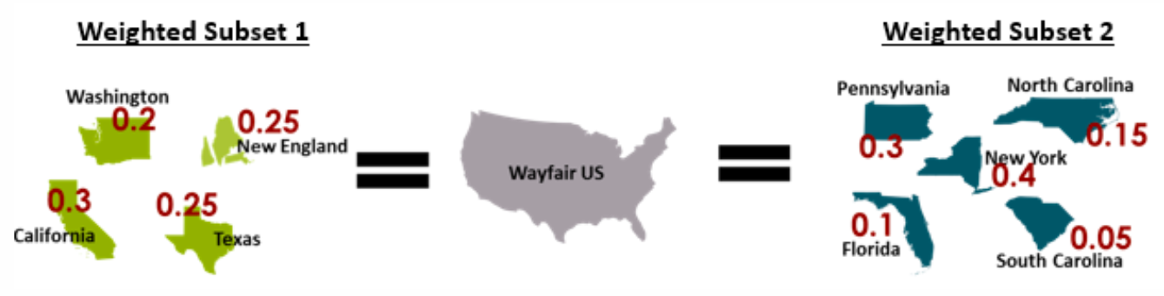
1 Introduction
Source: https://wytham.rbind.io/html/cbus_dsmeetup/econ_toolkit_2019-06-19.html#52

Slide 8
2 Propensity Score Matching
In this section, we will briefly cover the two types of data that is relevant in analyzing causality. Before we start, let’s get aligned on three key terms: ◼ Outcome variable: A variable of interest for which we want to understand treatment’s effect on. This is the effect. ◼ Treatment variable: A variable of interest for which we want to understand its impact on the outcome variable. This is the cause. ◼ Confounding variable: A variable that influences both the selection of treatment and the outcome variables. In some context, this is also referred to as covariate.
Source：https://towardsdatascience.com/propensity-score-matching-a0d373863eec

Slide 9
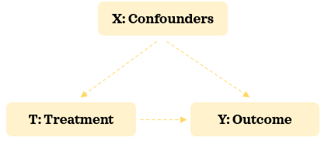
2 Propensity Score Matching

Slide 10
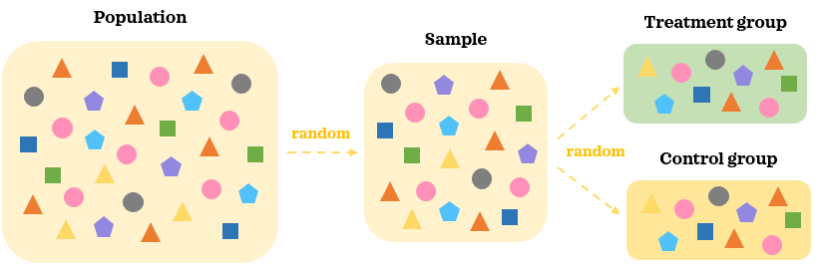
2 PSM - Experimental data
Data collected as part of an AB test (aka, randomized experiment, controlled study, randomized control trials and many more variants) is an experimental data. In an AB test, treatments are randomly assigned to the individuals and not selected by them. This means there is no selection bias and the treatment assignment is independent from any confounders.

Slide 11
2 PSM - Experimental data
In an AB test, a random representative large enough sample of the population is collected. Participants in the AB test are then randomly assigned to different treatment groups: A and B.
This random assignment helps splitting the participants into similar groups where the confounding factors are balanced.
When we introduce treatment to one group but not to the other, the key difference between the groups is the treatment. Since the groups are comparable in the absence of the treatment, we can reasonably say that statistically significant difference in the outcome between the groups is caused by the treatment.

Slide 12
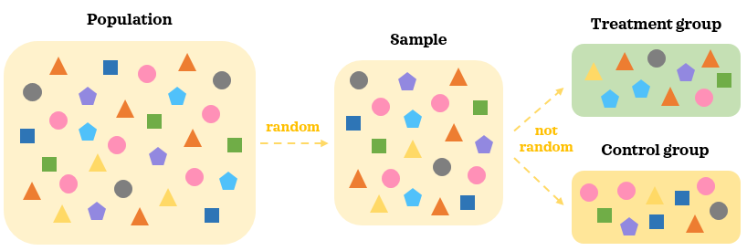
2 PSM - Experimental data
Any data that is not collected as part of an AB test is an observational data. In observational data, treatments are selected by the individuals and not randomly assigned to them. This means there is selection bias and treatment is no longer independent from the confounding factors.

Slide 13
2 PSM - Observational data
In observational data, we collect a random representative sample of the population.
As treatments are selected by individuals, there are likely to be differences in confounding factors between the groups. Hence, the two groups are not comparable to start with even in the absence of the treatment.
It’s hard to say that statistically significant difference in the outcome between the groups is caused by the treatment when there are other moving pieces at play.

Slide 14
2.0 PSM – oveall Steps
Propensity score matching is a non-experimental causal inference technique. It attempts to balance the treatment groups on the confounding factors to make them comparable so that we can draw conclusions about the causal impact of a treatment on the outcome using an observational data. There are 5 key steps when doing causal analysis with Propensity score matching:
1️⃣Collect data 2️⃣Estimate propensity scores 3️⃣Match records 4️⃣Evaluate matching 5️⃣Evaluate treatment effect on the outcome

Slide 15
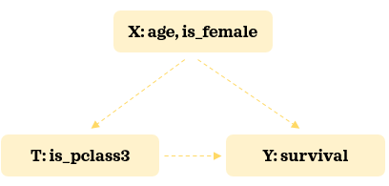
2.1 PSM - Collect data
The aim of this step is to collect data on all possible confounders based on the cases.
If important confounders are left out from the data, we will have a risk of falsely concluding about the causal impact of the treatment on the outcome. As our toy example, we will use the widely accessible titanic data. We will keep the number of confounders minimal to keep things manageable and easy to understand.
Here’s our hypothesized relationship structure:
We will try to understand the impact of getting third class cabin on survival rate.

Slide 16
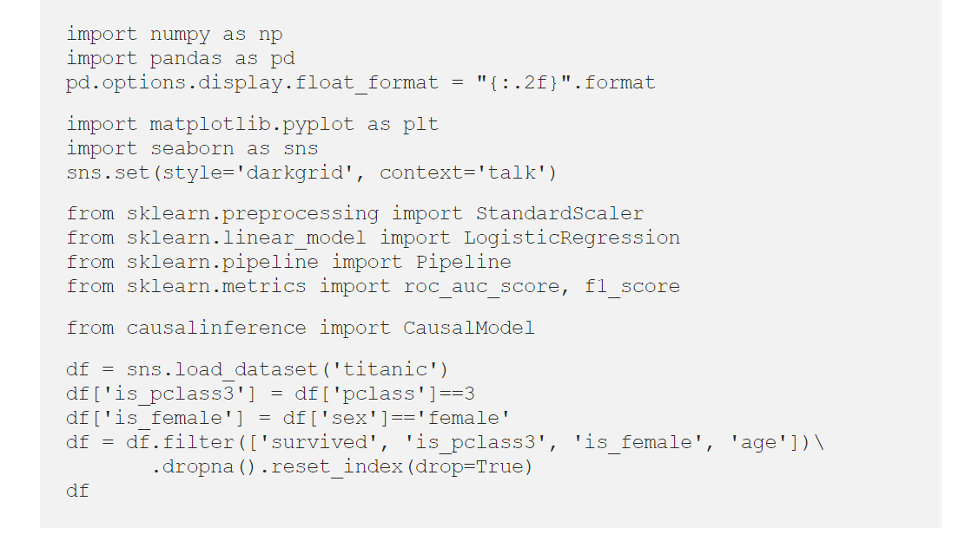
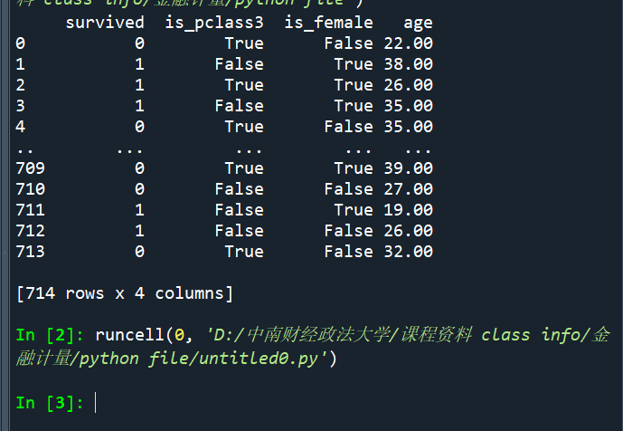
2.1 PSM - Collect data

Slide 17
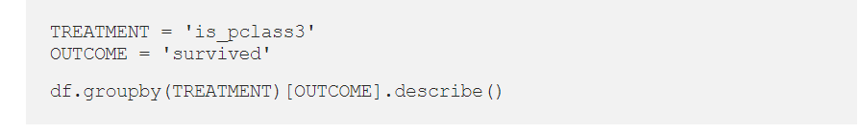
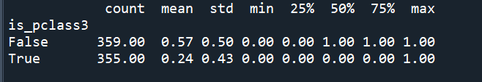
2.1 PSM - Collect data
Third class passengers’ (treatment group) survival rate is 24% whereas passengers from other classes (control group) have survival rate of 57%.

Slide 18
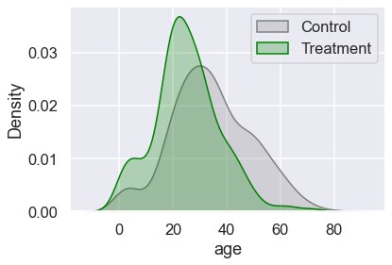
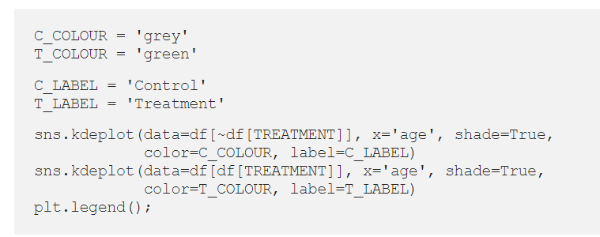
2.1 PSM - Collect data
Let’s now inspect the distribution of the confounders by the treatment groups:

Slide 19
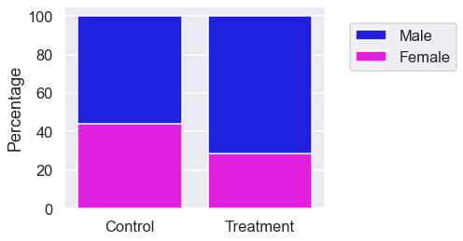
2.1 PSM - Collect data
Treatment group has more younger passengers compared to the control. Let’s check the distribution of gender:
Treatment group has more males. Since the confounding factors are not balanced between the two groups, it’s naïve to say that the difference in survival rate is due to the treatment at this stage. Now let’s learn how to make the groups more comparable.

Slide 20
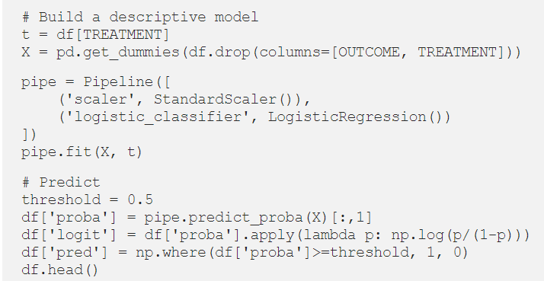
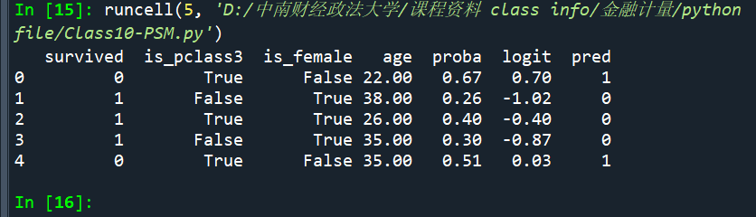
2.2.1 PSM - Estimate propensity scores
Once we have collected the data, we can build the propensity model predicting the probability of receiving the treatment given the confounders. Typically, logistic regression is used for this classification model.

Slide 21
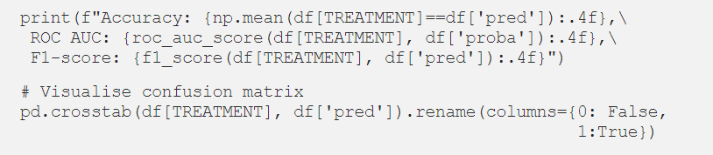
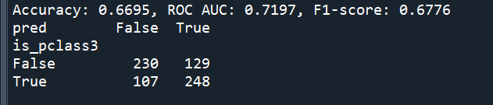
2.2.1 PSM - Estimate propensity scores
Propensity score tells us the probability of an individual getting the treatment given the confounders. We have also prepared the logit transformation of the propensity score. Let’s assess the model:

Slide 22
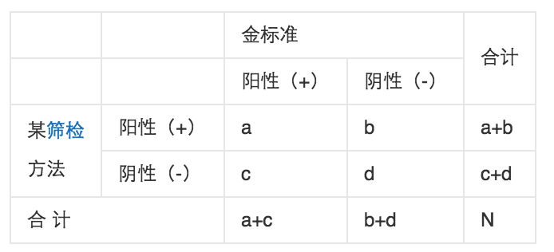
2.2.1 PSM - Estimate propensity scores
于是我们得到四个指标，分别为：真阳、伪阳、伪阴、真阴。ROC空间将伪阳性率（FPR）定义为 X 轴，真阳性率（TPR）定义为 Y 轴。
TPR（true positive rate）：在所有实际为阳性的样本中，被正确地判断为阳性之比率。TPR=TP/(TP+FN)
FPR（false positive rate）：在所有实际为阴性的样本中，被错误地判断为阳性之比率。FPR=FP/(FP+TN)

Slide 23
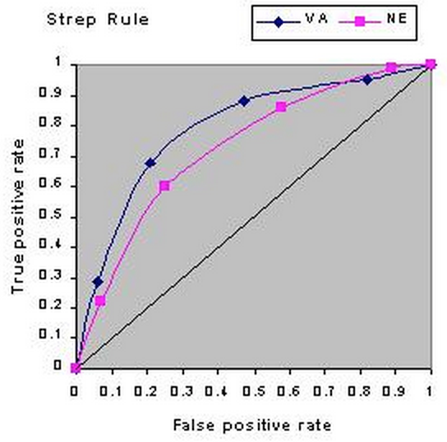
2.2.2 PSM - Estimate propensity scores
ROC（Receiver Operating Characteristic）
受试者工作特征曲线 (receiver operating characteristic curve，简称ROC曲线)，又称为感受性曲线(sensitivity curve)。
ROC曲线必定起于（0，0），止于（1，1）。因为，当全都判断为阴性(-)时，就是（0，0）；全部判断为阳性(+)时就是（1，1）。这两点间斜率为1的线段表示随机分类器（对真实的正负样本没有区分能力）。所以一般分类器需要在这条线上方。

Slide 24
2.2.2 PSM - Estimate propensity scores
ROC曲线最早是运用在军事上，后来逐渐运用到医学领域。相传在第二次世界大战期间，雷达兵的任务之一就是死死地盯住雷达显示器，观察是否有敌机来袭。理论上讲，只要有敌机来袭，雷达屏幕上就会出现相应的信号，但是实际上，有时如果有飞鸟出现在雷达扫描区域时，雷达屏幕上有时也会出现信号。这种情况令雷达兵烦恼不已:如果过于谨慎，凡是有信号就确定为敌机来袭，显然会增加误报风险;如果过于大胆，凡是信号都认为飞鸟，又会增加漏报的风险。每个雷达兵都竭尽所能地研究飞鸟信号和飞机信号之间的区别，以便增加预报的准确性。但问题在于，每个雷达兵都有自己的判别标准，有的雷达兵比较谨慎，容易出现误报;有的雷达兵则比较胆大，容易出现漏报。
为了研究每个雷达兵预报的准确性，雷达兵的管理者汇总了所有雷达兵的预报特点，特别是他们漏报和误报的概率，并将这些概率画到一个二维坐标里面。这个二维坐标的纵坐标为敏感性，即在所有敌机来袭的事件中，每个雷达兵准确预报的概率。而横坐标则为特异性，表示了在所有非敌机来袭信号中，雷达兵预报错误的概率。由于每个雷达兵的预报标准不同，且得到的敏感性和特异性的组合也不同。将这些雷达兵的预报性能进行汇总后，雷达兵管理员发现他们刚好在一条曲线上，这条曲线就是我们经常在医学杂志上看见的ROC曲线。

Slide 25
2.2.2 PSM - Estimate propensity scores
AUC（Area Under Curve）
AUC（Area Under Curve）被定义为ROC曲线下与坐标轴围成的面积，显然这个面积的数值不会大于1。又由于ROC曲线一般都处于y=x这条直线的上方，所以AUC的取值范围在0.5和1之间。AUC越接近1.0，检测方法真实性越高;等于0.5时，则真实性最低，无应用价值。
AUC = 1，是完美分类器。
AUC = [0.85, 0.95], 效果很好
AUC = [0.7, 0.85], 效果一般
AUC = [0.5, 0.7],效果较低，但用于预测股票已经很不错了
AUC = 0.5，跟随机猜测一样（例：丢铜板），模型没有预测价值。
AUC < 0.5，比随机猜测还差；但只要总是反预测而行，就优于随机猜测。

Slide 26
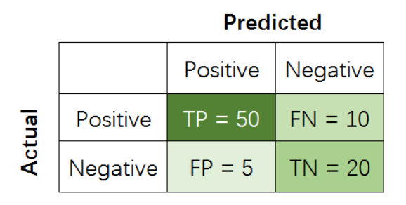
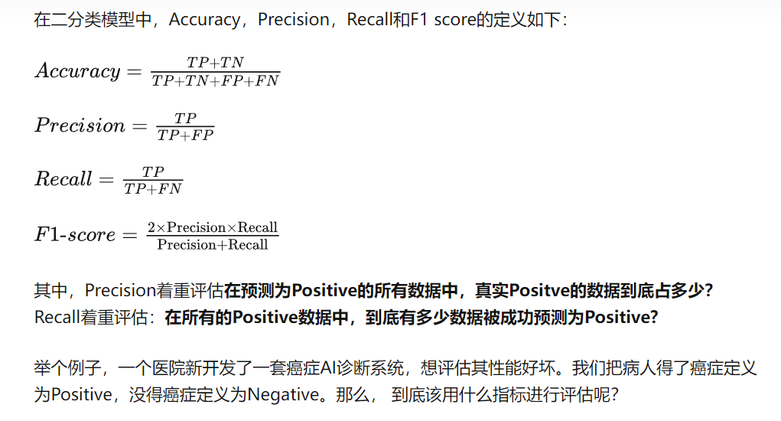
2.2.2 PSM - Estimate propensity scores
Source|: https://zhuanlan.zhihu.com/p/147663370

Slide 27

2.2.2 PSM - Estimate propensity scores

Slide 28
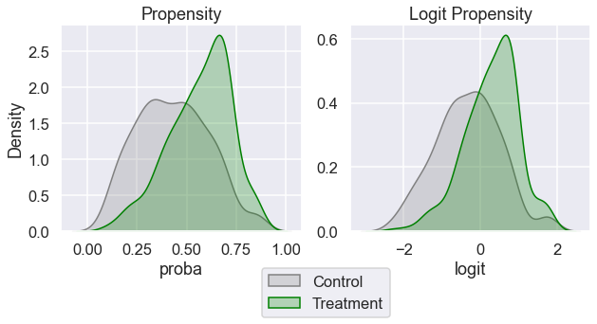
2.2.3 PSM - Estimate propensity scores
We will inspect the distribution of the propensity score and its logit transformation by the treatment groups:

Slide 29
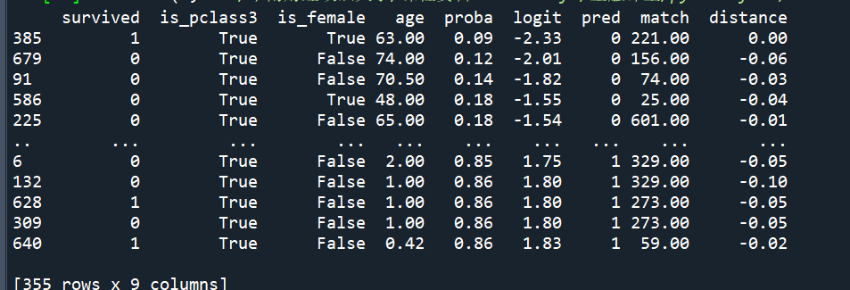
2.3 PSM – Match records
We will inspect the distribution of the propensity score and its logit transformation by the treatment groups:
In the following script, we find a control record with the most similar propensity score for each example in the treatment group (1 to 1 matching). When doing so, we will sample the control records with replacement. This means some control records can be matched multiple times to different treatment records whereas some control records are not matched at all:

Slide 30
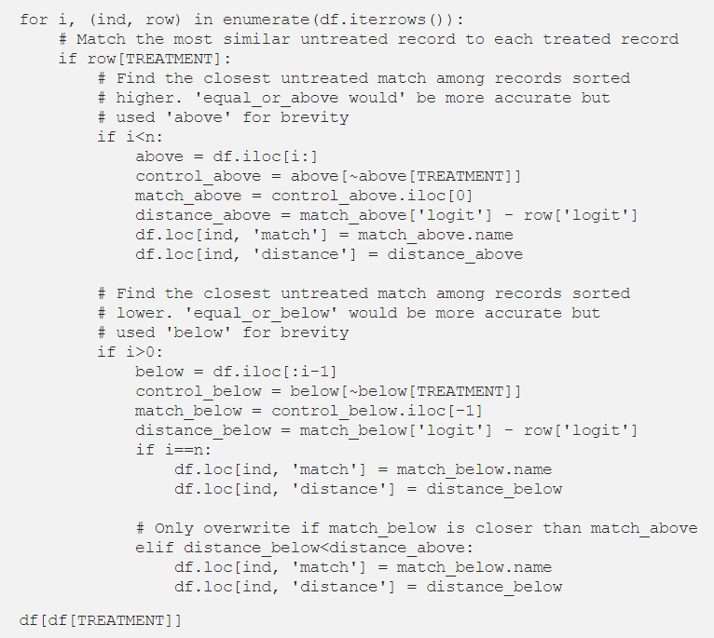
2.3 PSM – Match records

Slide 31
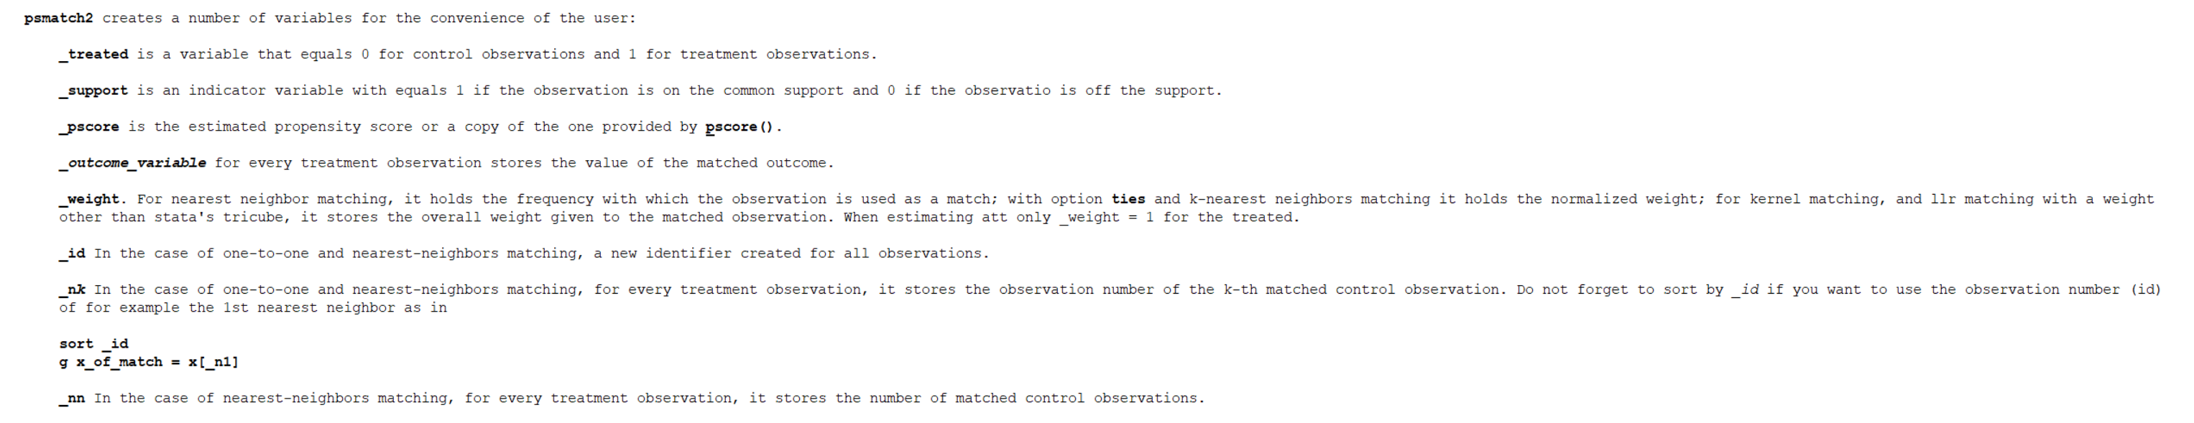
2.3 PSM – Match records - Stata
help psmatch2
One-to-one matching:
psmatch2 depvar [indepvars] [if exp] [in range] , [outcome(varlist) pscore(varname) ai(integer k>1) mahalanobis(varlist) caliper(real) noreplacement descending common trim(real) odds index logit ties warnings quietly ate]

Slide 32
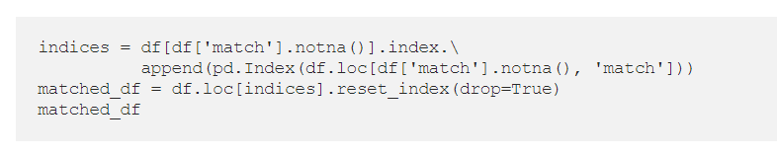
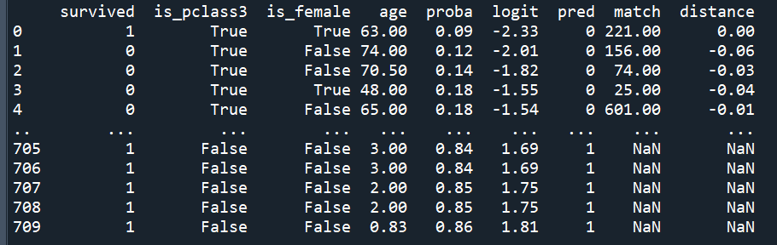
2.3 PSM – Match records - Stata
We will now create a new dataset called matched_df that contains the original treatment group and a new control group:

Slide 33
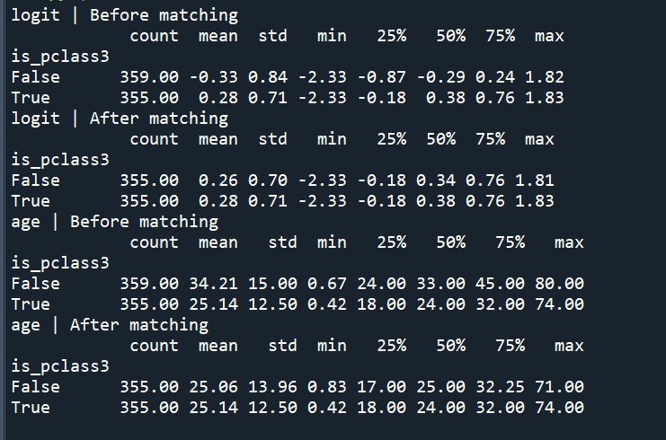
2.4 PSM – Evaluate matching
It’s time to evaluate how good the matching was. Let’s inspect if the groups look more comparable in terms of the confounders:

Slide 34
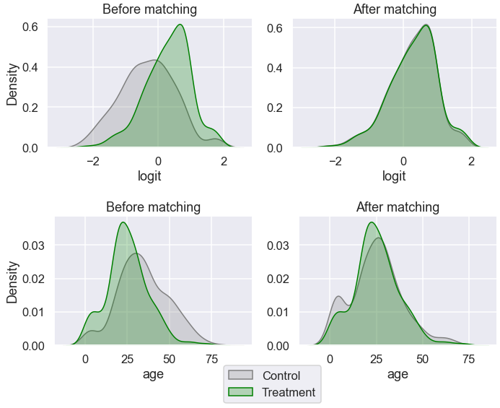
2.4 PSM – Evaluate matching
The distribution looks more similar between the groups now after the matching. Let’s visualize the distributions:

Slide 35
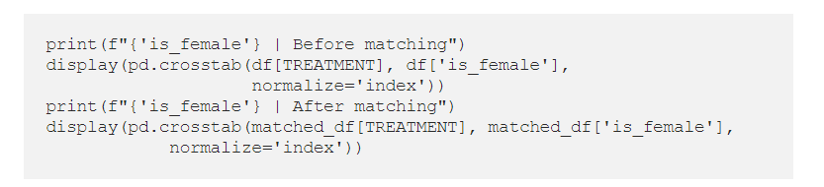
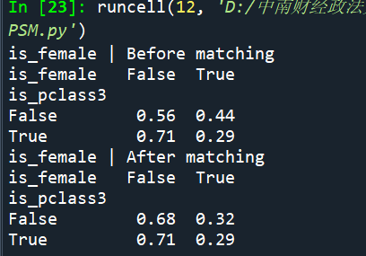
2.4 PSM – Evaluate matching
Age looks more balanced between the groups than before. Let’s inspect the distribution of gender:

Slide 36
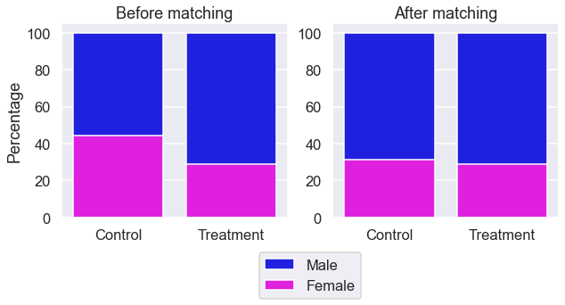
2.4 PSM – Evaluate matching

Slide 37
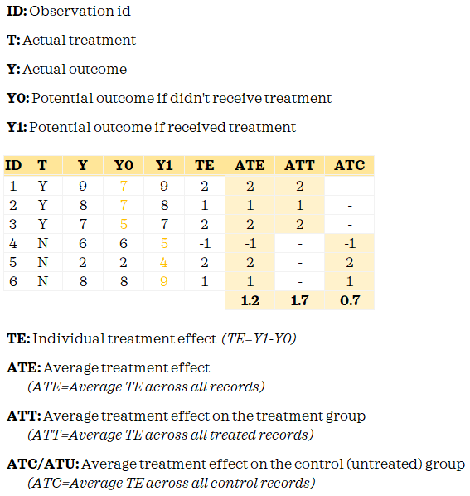
2.5 PSM – Evaluate treatment effect

Slide 38
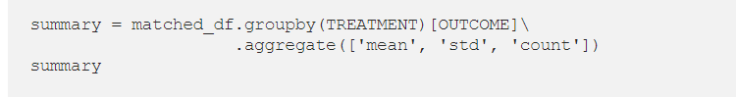
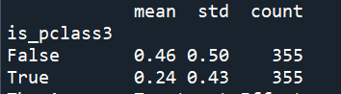
2.5 PSM – Evaluate treatment effect
The fundamental problem of causal inference is that we don’t observe both potential outcomes. We only know the Y0 for the control group and have Y1 for the treatment group. When we matched records, we attempted to proxy Y0 for the treated records so that we could measure the treatment effect.

Slide 39
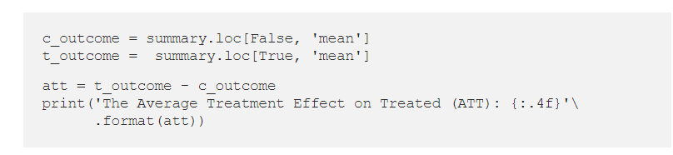
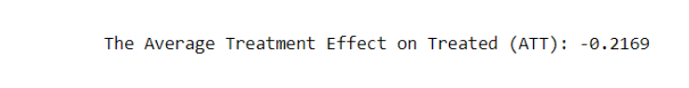
2.5 PSM – Evaluate treatment effect
Let’s estimate average treatment effect on the treated:

Slide 40
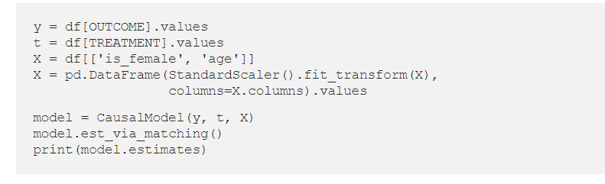
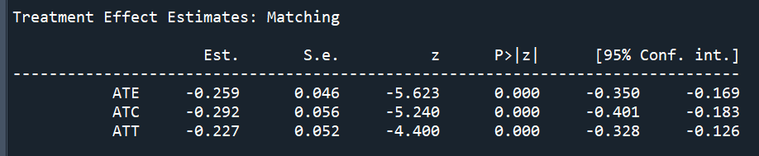
2.5 PSM – Evaluate treatment effect
We have looked at a simplistic manual example to understand of the intuition behind Propensity score matching. In practice, it’s often wiser and more practical to use dedicated libraries such as causalinference

Slide 41
3 Synthetic Control
Introduced in 2003 and formalized in 2010 by Alberto Abadie and colleagues, the synthetic control aims to bridge between the traditional qualitative approaches of the social sciences and the modern data driven approaches.
It strikes a balance between the two by offering a clear objective function to optimize while constraining the model to remain transparent, interpretable and simple.
It is applicable to almost any domain, and became very popular thanks to its lenient assumptions. Esteemed economists Susan Athey and Guido Imbens have called it “arguably the most important innovation in the policy evaluation literature in the last 15 years”.
https://tom-beer.github.io/post/synthetic-control/

Slide 42
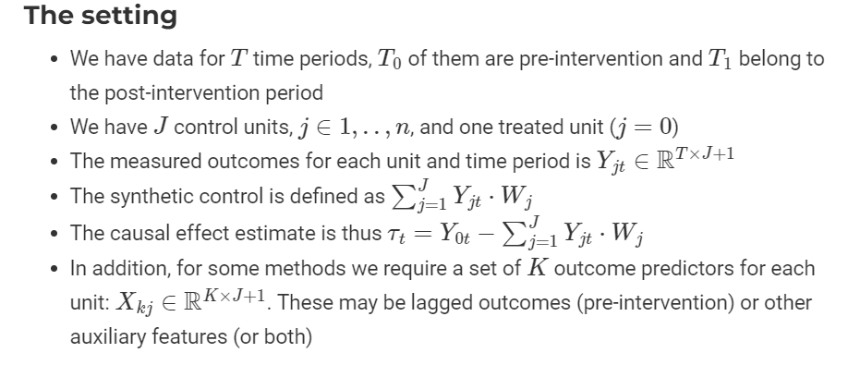
3 Synthetic Control

Slide 43
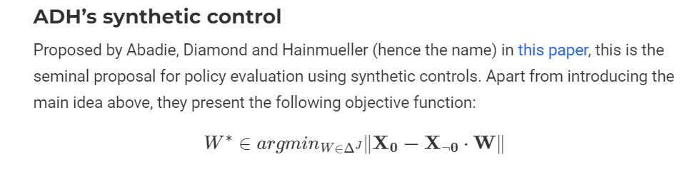
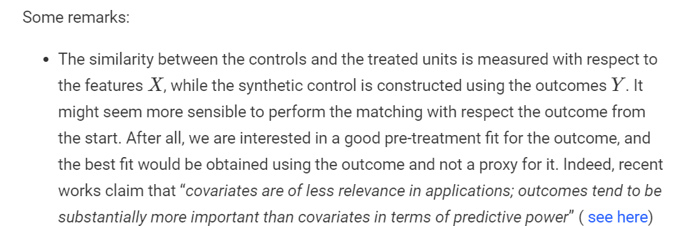
3 Synthetic Control

Slide 44
3 Synthetic Control
Estimating the effect of California’s tobacco control program
The case of California’s tobacco control program was one of the first applications of the synthetic control method, and it was introduced in this paper.
The research question
In 1988 California implemented a large scale tobacco control program, called proposition 99, that increased California’s cigarette excise tax by 25 cents per pack, earmarked the tax revenues to health and anti-smoking education budgets, funded anti-smoking media campaigns, and spurred local clean indoor-air ordinances throughout the state.
The question we are interested here it to evaluate the policy’s effect in terms of per-capita cigarette consumption. The potential controls in this case are all US states

Slide 45
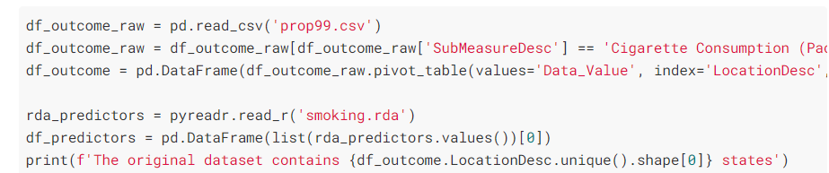
3 Synthetic Control
Data: https://github.com/johnson-shuffle/mixtape/tree/master/data
The original dataset contains 51 states
As part of the method’s assumptions and requirements, it is important to exclude from the donor pool (this is how the collection of control units is traditionally called) any unit that may not be a true control - i.e. any unit that has implemented a similar intervention. Some states also introduced anti-smoking programs or substantially increased the tax for cigarettes:

Slide 46
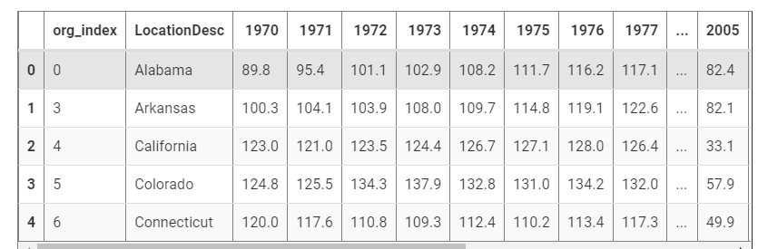
3 Synthetic Control
After filtering out some states, we are left with 39 states (including California):

Slide 47
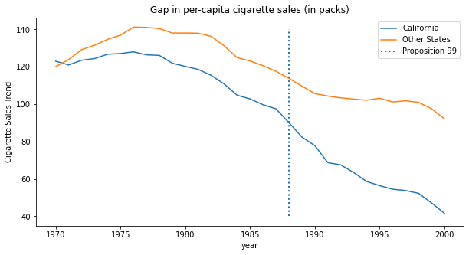
3 Synthetic Control
If we plot the outcomes for California vs. an average of all US states, we see that the ‘average control state’ is not like California in the pre-intervention period, violating the parallel trends assumption required to draw inferences. Therefore we will find an optimal weighting that would attain a good fit to California in the pre-intervention period.

Slide 48
3 Synthetic Control
To estimate the treatment effect with synthetic control, we will try to build a “fake unit” that resembles the treated unit before the intervention period. Then, we will see how this “fake unit” behaves after the intervention. The difference between the synthetic control and the unit that it mimics is the treatment effect.
To do so, the first thing we need is to convert the units (in our case, the states) into the columns and the time into the rows. Since we have 2 features, cigsale and retprice, we will build a synthetic control that looks a lot like California in the pre intervention period based on the 2 features, and see how it would behave in the post intervention period.
For this reason, it is important that we select only the pre-intervention period. Here, the features seem to be on a similar scale, so we won’t do anything to them. If features are in different scales, one in the thousands and another in the decimals, the bigger feature will be the most important when minimizing the difference.
To avoid this, it’s important to scale them first.

Slide 49
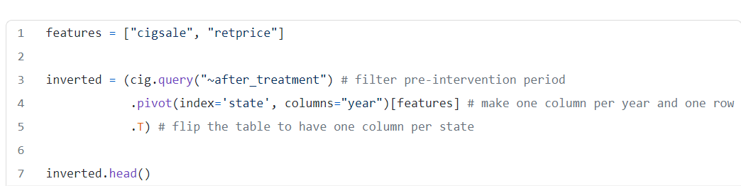
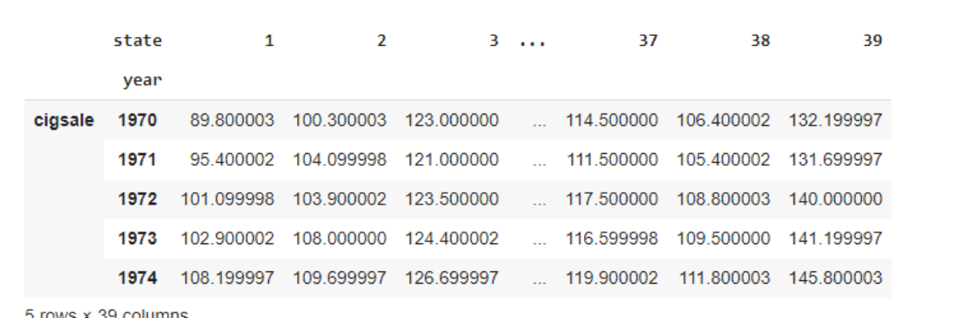
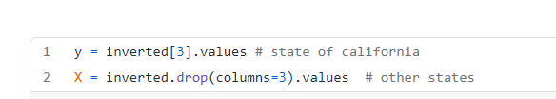
3 Synthetic Control

Slide 50
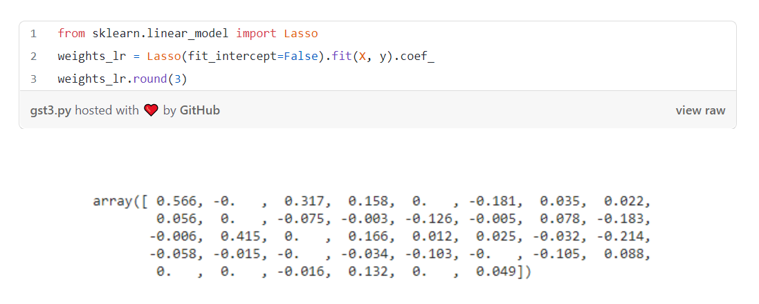
3 Synthetic Control
These weights show us how to build the synthetic control. We will multiply the outcome of state 1 by 0.566, of state 3 by 0.317, of state 4 by 0.158, and so on.

Slide 51
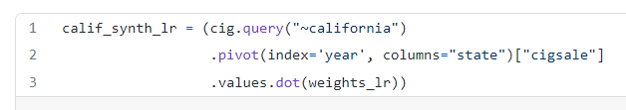

3 Synthetic Control
Then we can get the Synthetic Control data with a dot product between the matrix from the states in the pool and the weights.

Slide 52

3 Synthetic Control

Slide 53


3 Synthetic Control

Slide 54

3 Synthetic Control
Here, we will use the idea of Fisher’s Exact Test. Its intuition is very simple. We permute the treated and control exhaustively. Since we only have one treated unit, this would mean that, for each unit, we pretend it is the treated while the others are the control.

Slide 55

3 Synthetic Control
In the end, we will have one synthetic control and effect estimates for each state. So what this does is it pretends that the treatment actually happened for another state, not California, and see what would have been the estimated effect for this treatment that didn’t happen. Then, we see if the treatment in Califórnia is sufficiently larger when compared to the other fake treatment. The idea is that for states that weren’t actually treated, once we pretend they were, we won’t be able to find any significant treatment effect.

Slide 56

3 Synthetic Control

Slide 57

3 Synthetic Control
Two aspects of last figure jump to the eyes.
First, we can see that the variance after the intervention is higher than the variance before the intervention. This is expected since the synthetic control is designed to minimize the difference in the pre-intervention period.
Another interesting aspect is that there are some units we can’t fit very well even in the pre-intervention period. This is also to be expected.
Since those units are so poorly fit, it is a good idea to remove them from the analysis. One way to do it objectively is to set a threshold for pre-intervention error and remove those units with high errors. If we proceed like this and plot the same figure, this is what we get.

Slide 58

3 Synthetic Control
This picture alone is a form of inference, but we can also derive a P-value from these results. All we have to do is see how many times the effects that we’ve got is below the effect of California.

Slide 59

3 Synthetic Control

Slide 60

3 Synthetic Control
If we want to test the one sided hypothesis that the effect in California is below zero, we can estimate the P-value as the proportion of times the effect in California is bigger than all the estimated effects.
As it turns out, the treatment effect for California in the year 2000 is -31, meaning that the intervention reduced the consumption of cigarettes by almost 31 packs. Out of all the other 34 placebo effects that we’ve estimated, only one is higher than the effect we found in California. So the p-value would be 0/35.
P value=0

Slide 61

3 Synthetic Control

